Slide 1
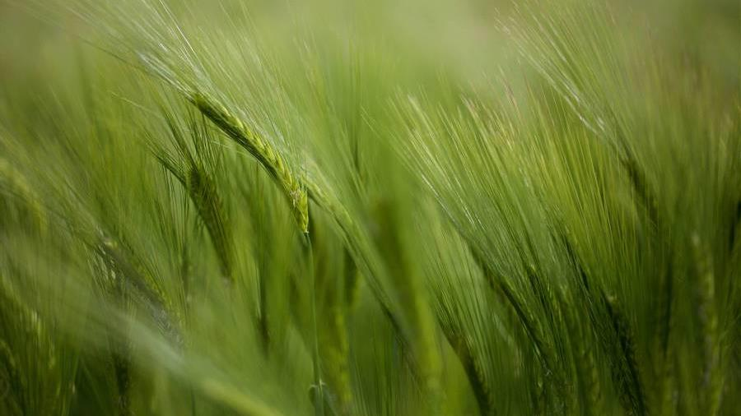
Heart Disease
Machine Learning to Predict Heart Disease,
Improving overall health
From Group ?

Slide 2
Overview
Our Inspiration
Concept
Data Collection
Preparation of Data
Predictive Modeling
Visualizations/Demo and insights
Conclusions
Questions
Resources

Slide 3
Inspiration
Health History
Health care
Landscape has forever changed
Grocery has had the biggest shift in shopping abits
Providing recommendations will ease meal planning stress
Our objective is to create a Machine learning model for detecting heart disease which is a cause of heart failure by focusing on various causative attributes. The aim is to predict early signs of heart disease in order to identify individuals who might be at risk of developing heart problems. By analyzing relevant data, we can anticipate to identify potential issues early on based on certain variables/features. This approach not only improves health outcomes but also ensures that healthcare resources are used more efficiently.
Notes:
The ongoing pandemic has changed the landscape of grocery shopping forever. Online grocery shopping has become the new norm, and studies show that most consumers do not intend to go back.
The challenge is what to buy sight unseen, and how to we add variety to our carts without searching endless recipe blogs and Pinterest boards- or even more importantly, how do we know that we would even like something new?
Citation: Forbes- The Pandemic Changed How We Shop for Groceries, Joan Verdon, 3/15/2022 (https://www.forbes.com/sites/joanverdon/2022/03/15/the-pandemic-changed-how-we-shop-for-groceries-adobe-report-shows/?sh=6d7b5c624bb1)

Slide 4

Concept
data
Gather patient data for correlation and predictive analysis.
Usability
Additional purchases/sales promotion
Improved ordering and inventory planning
Increased health benefits for customers
Future expansion to include recipes, etc.
technology
Use Machine Learning (ML) to process the data and make predictions based on patient medial history
Integration
Easy to use, user friendly, adaptable coding

Slide 5




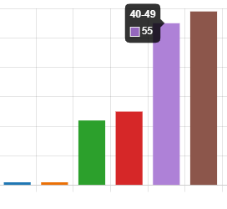
baseline Data collection
Targets
design
delivery
insights
Variety
Factors, Frequency, Favorites
Forms Survey Shared
Did We Meet the Mark?

Slide 6



Preparation of baseline Data
Data Conversion
Clean up
model BUILDING AND SELECTION
Exporting from Forms
to .csv
Creating dataframes (DFs)
Adding new columns back into main DF
Renaming columns as needed
Using delimiters to split response choices
Testing different machine learning models to determine which model would be the best fit
Notes:
We were able to easily download the data via Kaggle, and then converted to .csv to make dataframes
When it came to getting the data ready to process and analyze the data was pretty much cleaned it only needed to be normalized and adding of columns.
Creating a dataframe that change strings to floats in order to split data before creating Machine Learning model
In the end we had a dataset that had 20 columns versus the original 12 features- where there were rows with 1s (indicating yes ) and rows with 0s (indicating no).

Slide 7
CODING PROCESS

Slide 8
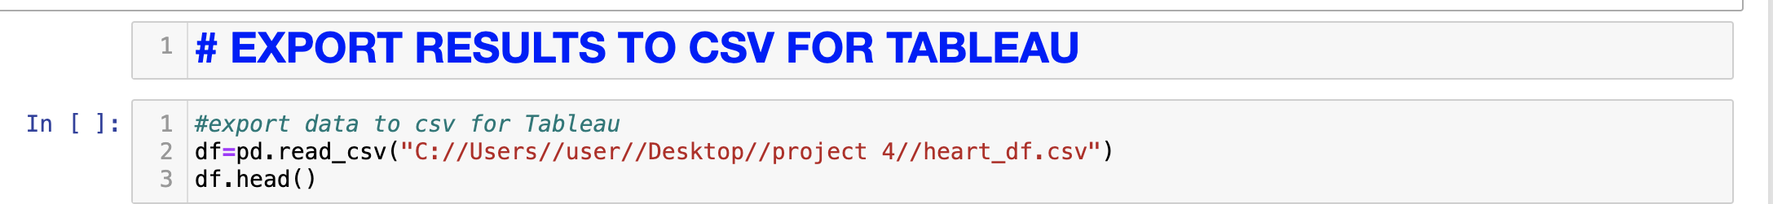
Visualizations/Demo and insights
Tableau Visualizations:
https://public.tableau.com/app/profile/mehrin.khan/viz/HeartDisease_17074856563830/HEARTDISEASEDASHBOARD#1
Model Demo:
http://127.0.0.1:5501/Templates/index.html

Slide 9
Solution & Conclusions
Lessons Learned
Mapping out the predictions worked well.
We were able to get some interesting insights for other correlations as well.
This model offers opportunities to make suggestions for additional problems within the healthcare sector

Slide 10
Thank you! Questions?

Slide 11

Appendix References/Resources
Our GitHub Repo: https://github.com/Prisca92/Project-4-final
Data collection: (https://www.kaggle.com/datasets/fedesoriano/heart-failure-prediction/data)
Coding Resources:

